Slide 1
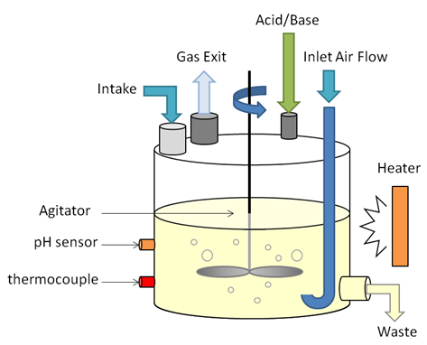
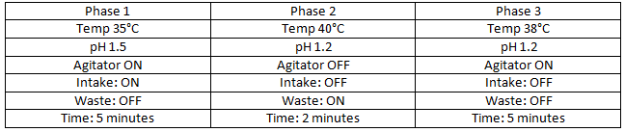
Example - Bioreactor
UI that allows the operator to do the following:
Define and run recipes
Monitor current pH level and temperature
In case of failure:
Abort a running recipe
Override temp & pH setpoints
Update rates < 500 Hz
Sample Recipe

